Slide 1

Maximizing Stock Portfolio Growth in US Market
Pinyo Kewdumrongtum Rebecca Tang
Ethan Sung
(312712017) (312712013)
(313712003)

Slide 2
Agenda
Project Motivation
Overview Study Plan
3. EDA Outcome and Analysis
4. Model Selection and Predictive Result
5. Portfolio KPI Measurement
IDA Template

Slide 3
Overview Study Plan
Stock Selection
Data Collection
Exploratory Data Analysis (EDA)
Selected Stocks:
- Exxon Mobile (XOM)
- Pfizer (PFE)
- Microsoft (MSFT)
Using Python programming to export past recorded stock price from “yahoofinance”
(ref: https://finance.yahoo.com/markets/)
Outcome Diagram:
General stock price plot vs time
Box Plot
Normal distribution plot of return
Time series return
Sharp Ratio
Portfolio KPI Measurement
Model Selection for training & testing
Benchmark with ‘Equal-weigth Average Portfolio’ in the term of:
Annual Return
Sharp Ratio
Max. Drawdown
Volatility
Selected Models:
ARIMA
Random Forrest
XGBOOST
Using ‘K-Fold Cross Validation’ concept to train and test
IDA Template

Slide 4
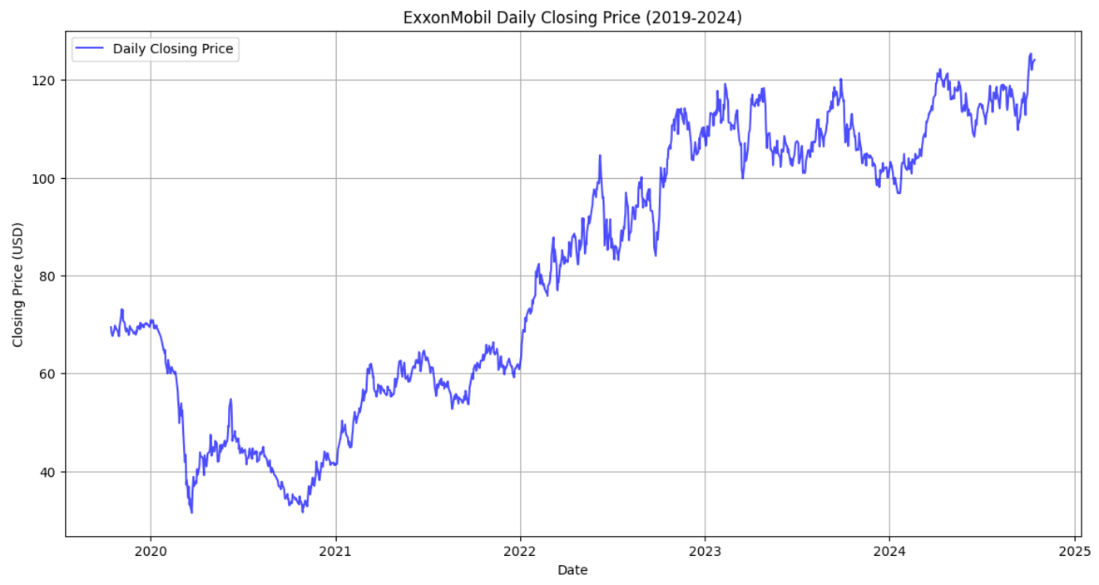
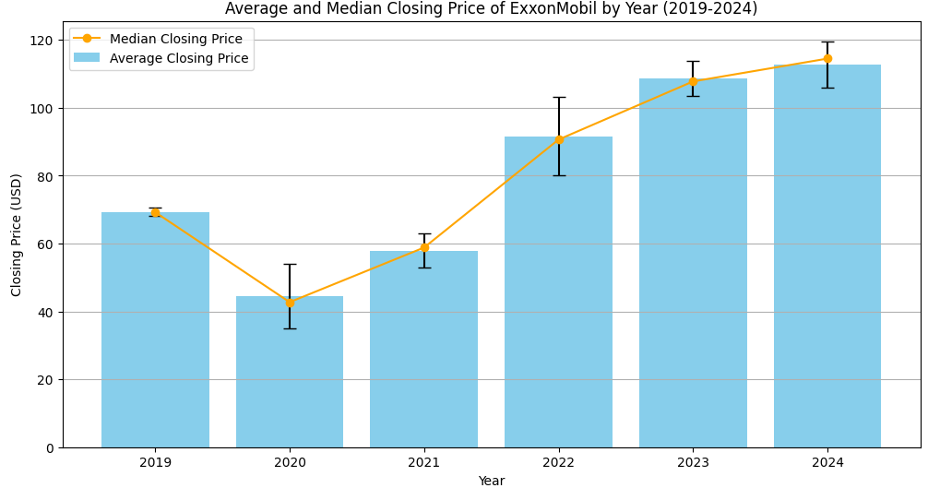
EDA Outcome and Analysis
1. Exxon Mobile
XOM stock price shows:
1. Continuous upward trend since 2020
2. Show the long term and sustainable growth
3. Growth rate is less after 2023
The diagram shows that:
Average closing price and median price by year is almost equal
Variance of closing price in 2020 and 2022 are higher than other years
IDA Template

Slide 5
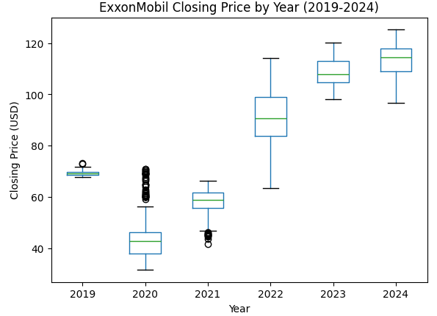
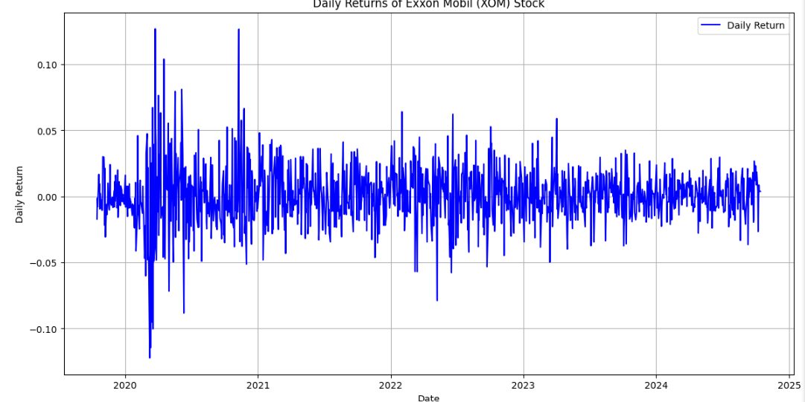
EDA Outcome and Analysis
1. Exxon Mobile
Box plot diagram shows that:
2020 has many outliers than other years meaning that the price variation is extremely fluctuated
Daily return diagram shows that:
The variation of daily return is high during 2020 to 2021, and it is gradually reduced after 2021
IDA Template

Slide 6
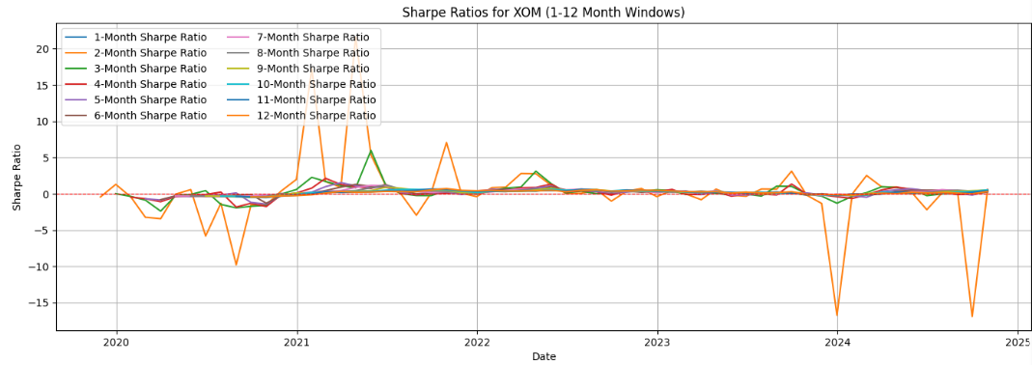
EDA Outcome and Analysis
1. Exxon Mobile
Sharp Ratio shows that:
2- and 3- months sharp ratio period provide the highest return from XOM stock
Period Selection of Dynamic Strategy:
3 months might be a good period for a dynamic strategy since it provide above average return with less risk compared to 2 months
IDA Template

Slide 7
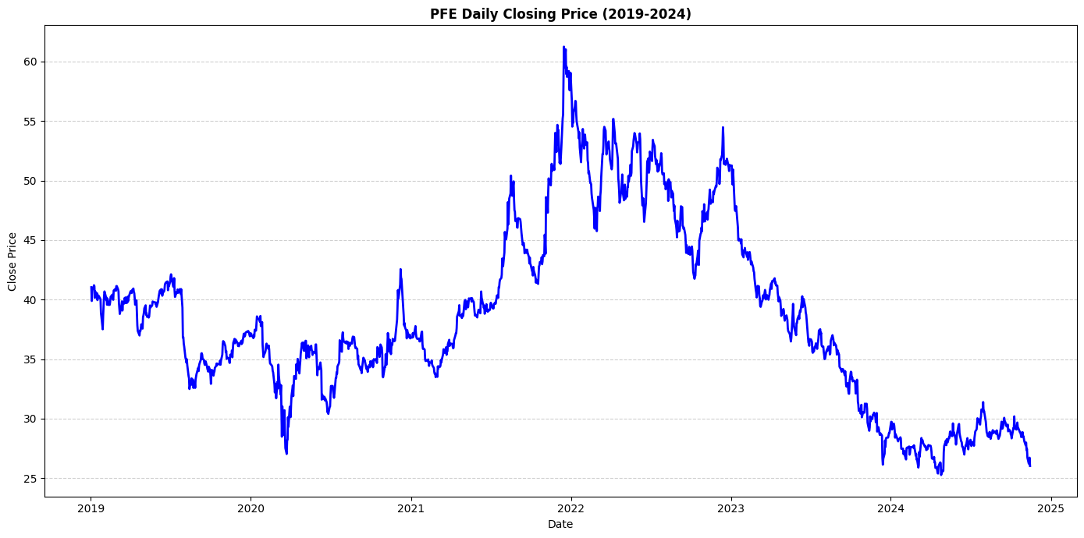
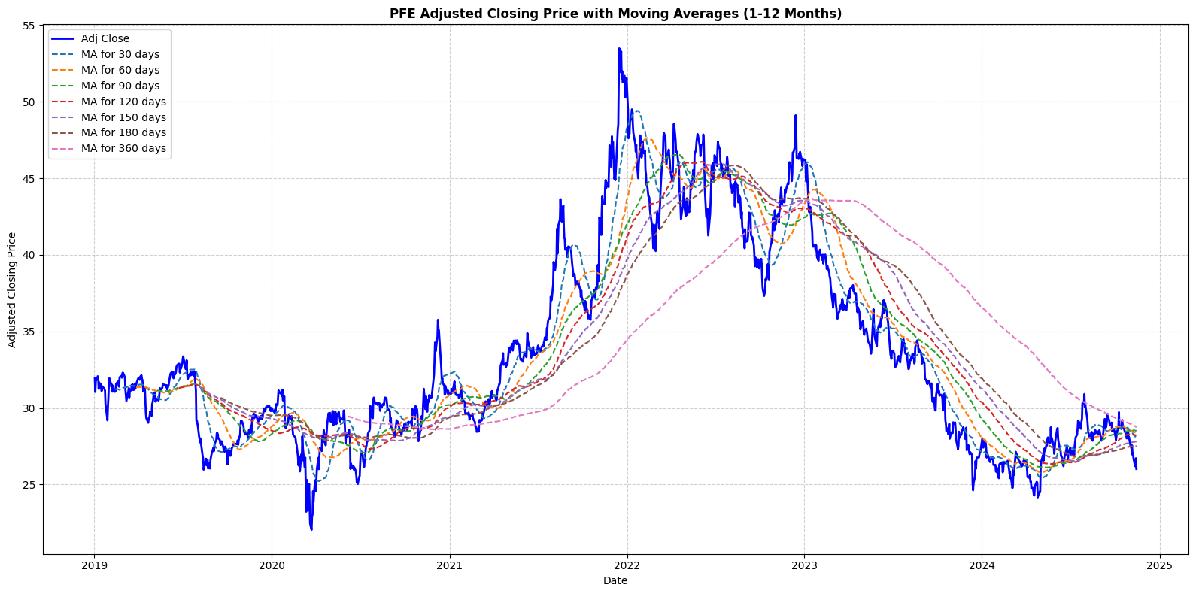
EDA Outcome and Analysis
1. Pfizer
PFE stock price shows:
2022 Peak: Due to pandemic (over $60)
2. 2023-2024 Decline: Steadily declined from the 2022 peak to around $30.
3. Support Zone: The current price is close to the support range in 2019-2020 ($30-$40).
The average shows that:
1. Since the peak in 2022, all MA have gradually declined, indicating a long-term downtrend. Additionally, short-term MAs are mostly below long-term MAs, further confirming market weakness
IDA Template

Slide 8
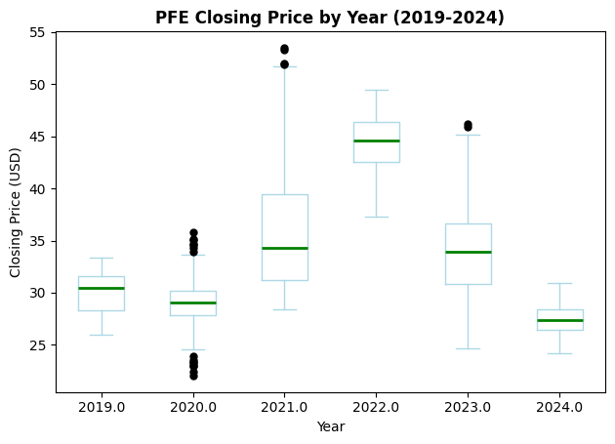
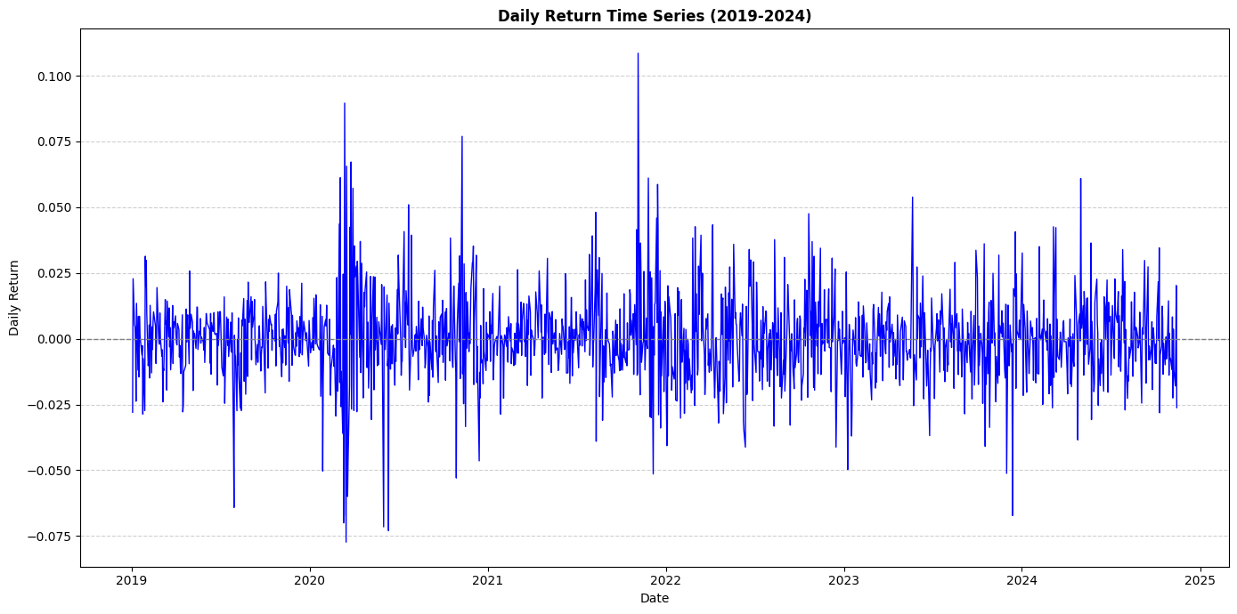
EDA Outcome and Analysis
1. Pfizer
Box plot diagram shows that:
1.2020: Low outliers below due to pandemic-induced panic selling.
2.2021: High outliers possibly related to revenue surge from vaccine business.
3.2023: High outliers likely driven by short-term rebounds or market optimism.
Daily return diagram shows that:
2020-2021 has many outliers than other years meaning that the price variation is extremely fluctuated
IDA Template

Slide 9
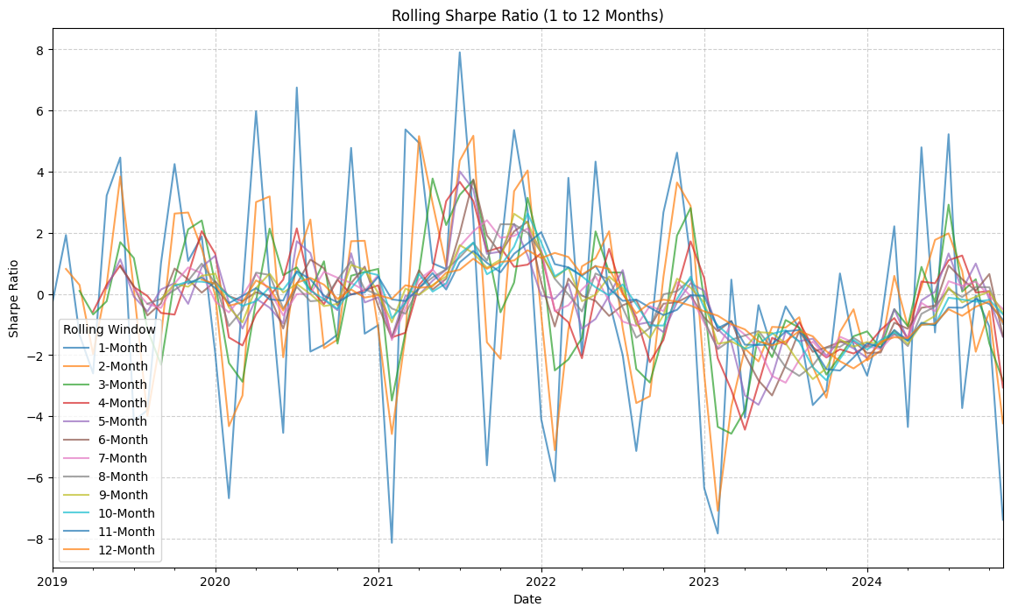
EDA Outcome and Analysis
1. Pfizer
Period | Average Sharpe | Analysis
1-3 Months | 5.62 | Highest Sharpe Ratio, suitable for short-term investment.
4-6 Months | 3.81 | Stable returns, good for mid-term investment.
7-9 Months | 2.44 | Sharpe Ratio starts declining, long-term returns weaken.
10-12 Months | 2.03 | Lowest Sharpe Ratio, long-term holding not recommended.
Period Selection of Dynamic Strategy:
Short-term investments (1-3 months) have the highest average Sharpe Ratio (5.62), indicating the best risk-adjusted returns and suitability for quick profit strategies.
IDA Template

Slide 10
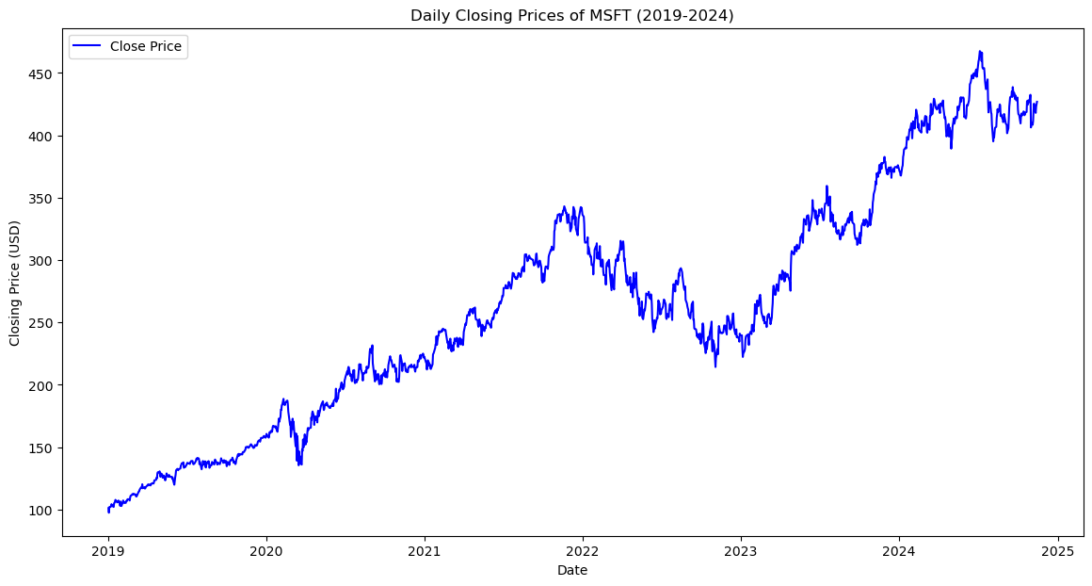
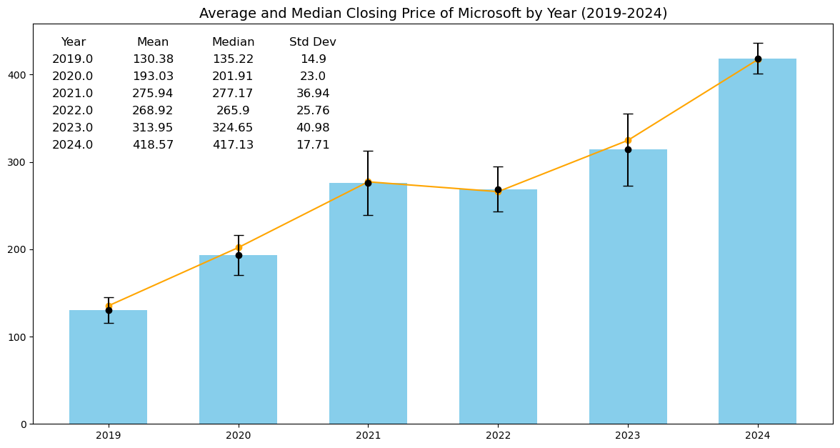
EDA Outcome and Analysis
3. Microsoft Corp (MSFT)
MSFT stock price shows:
2020 recovery from cloud demand
2022 correction due to rates
Stable growth post-2023, >$400
The diagram shows that:
1. Average and Median Closing Price: The yearly average and median closing prices are nearly identical
2. Variance: Closing prices in 2021 and 2023 show higher variance compared to other years
IDA Template

Slide 11
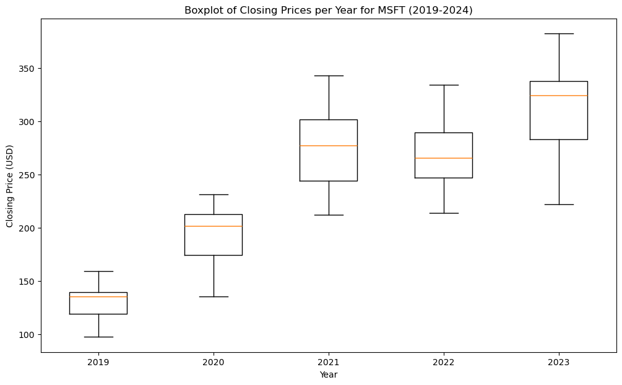
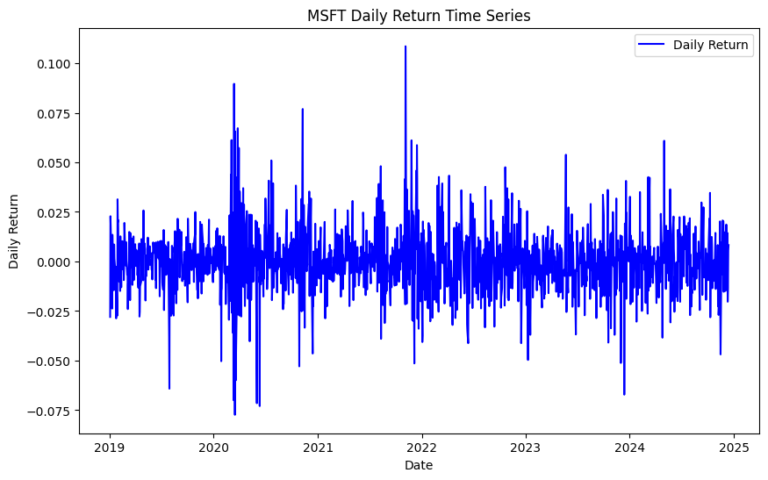
EDA Outcome and Analysis
3. Microsoft Corp (MSFT)
Box plot diagram shows that:
From 2019 to 2024,median closing price showed consistent growth. However, the widening interquartile range indicates increasing volatility
Daily return diagram shows that:
In 2020, significant volatility highlights market instability, while post-2021 shows decreased fluctuations, indicating more stable performance
IDA Template

Slide 12
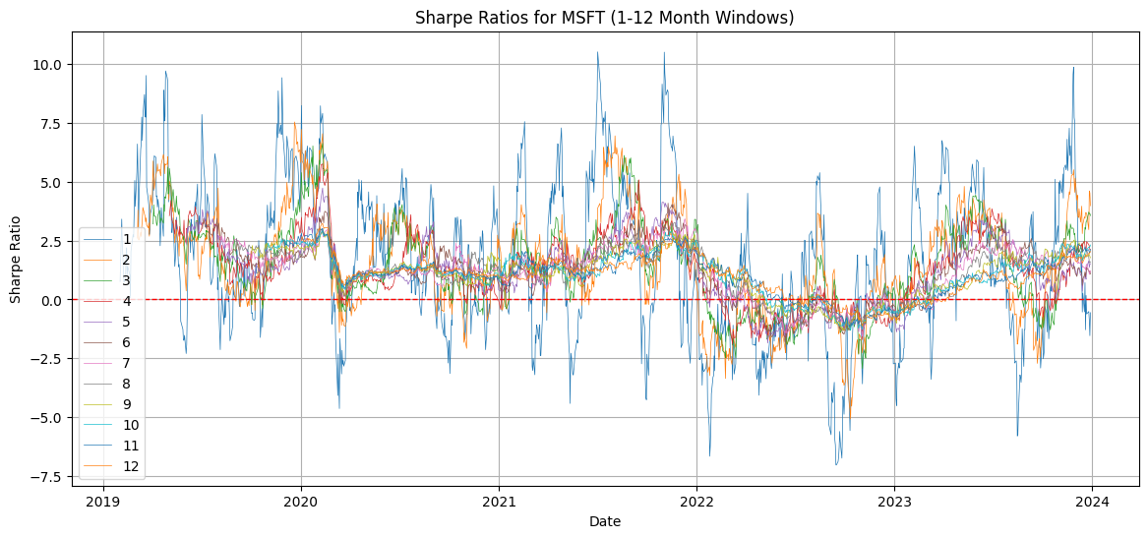
EDA Outcome and Analysis
3. Microsoft Corp (MSFT)
Sharp Ratio shows that:
Short-term investments (1-3 months) show the highest average Sharpe Ratio, making them ideal for quick profit strategies
Period Selection of Dynamic Strategy:
Longer-term periods (6-12 months) offer more stable but moderate returns, suitable for conservative investors
IDA Template

Slide 13
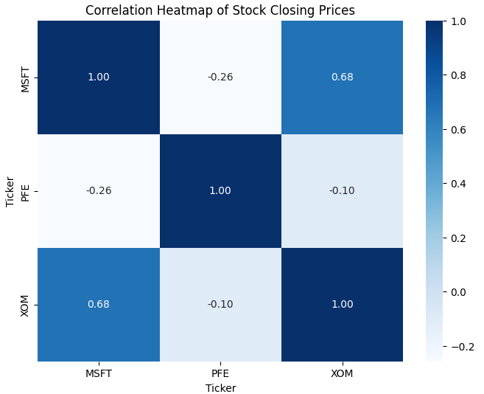
EDA Outcome and Analysis
Stock Correlation Heat Map
Correlation heat map shows that:
The correlation between a pair of stocks is not closely related
IDA Template

Slide 14
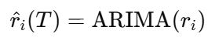
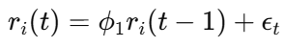
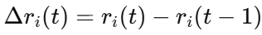
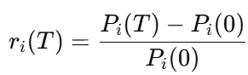
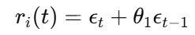
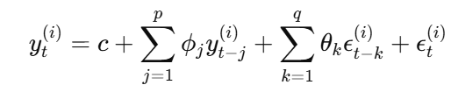
Auto Regressive Integrated Moving Average (ARIMA)
Objective Eq.:
Predictive Eq.:
AR:
I:
MA:
IDA Template

Slide 15
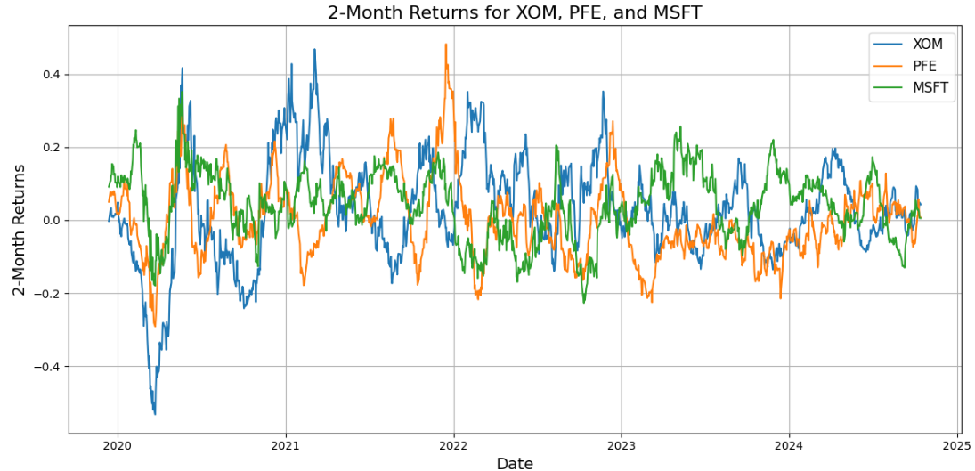
Auto Regressive Integrated Moving Average (ARIMA)
Step 1 : Calculate return from the stocks every 2 months
Step 2 : Separate training and testing dataset (70% training, 30% testing)
IDA Template

Slide 16
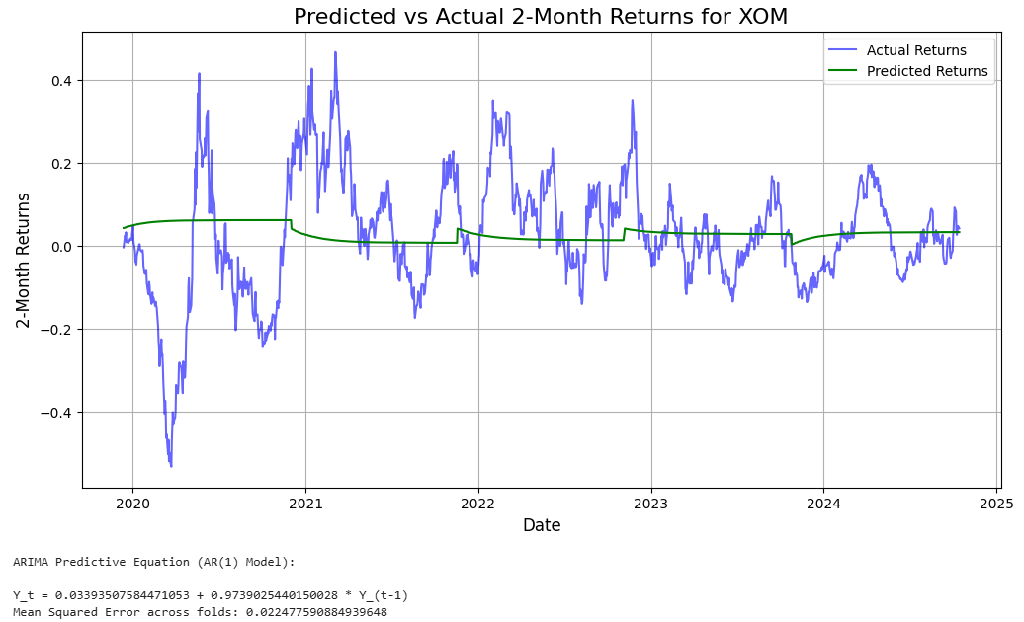
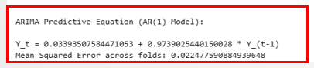
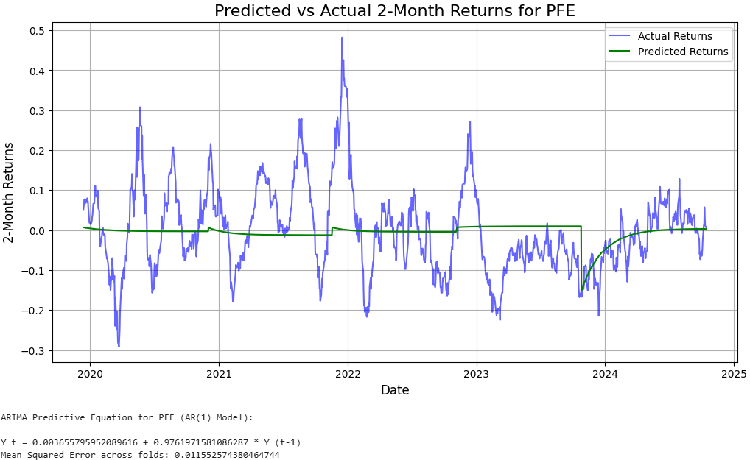
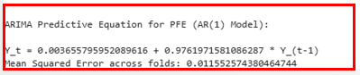
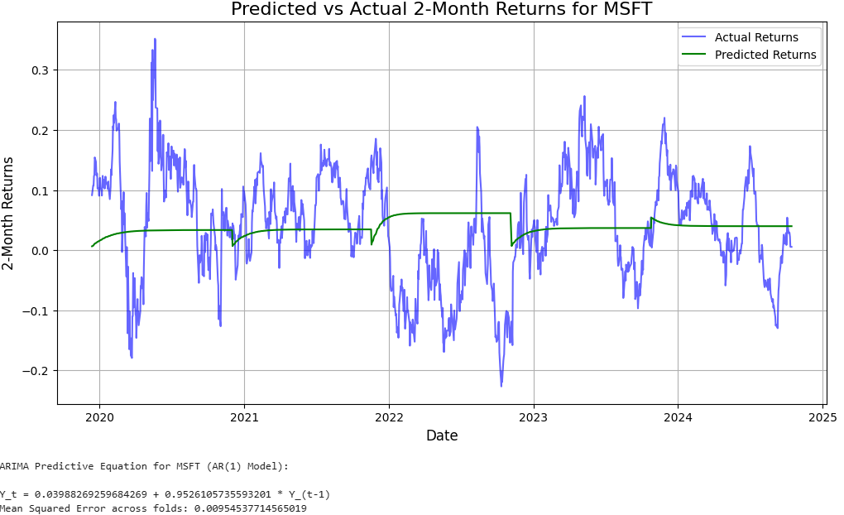
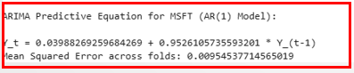
Auto Regressive Integrated Moving Average (ARIMA)
Step 3 : Run ARIMA model to find the predictive equation and test the model by using K-Fold Cross Validation approach
IDA Template

Slide 17
Auto Regressive Integrated Moving Average (ARIMA)
Predictive Model Conclusion
Stocks | β0 | β1 | MASE Across Fold
XOM | 0.0339 | 0.9739 | 0.0224
PFE | 0.0036 | 0.9761 | 0.0115
MSFT | 0.03988 | 0.9526 | 0.0095
IDA Template

Slide 18
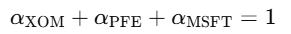
Auto Regressive Integrated Moving Average (ARIMA)
Step 4 : Combine predictive equation of returns from XOM, PFE, and MSFT
While,
IDA Template

Slide 19
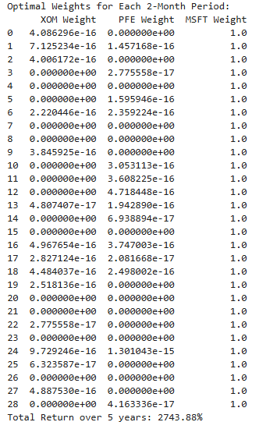
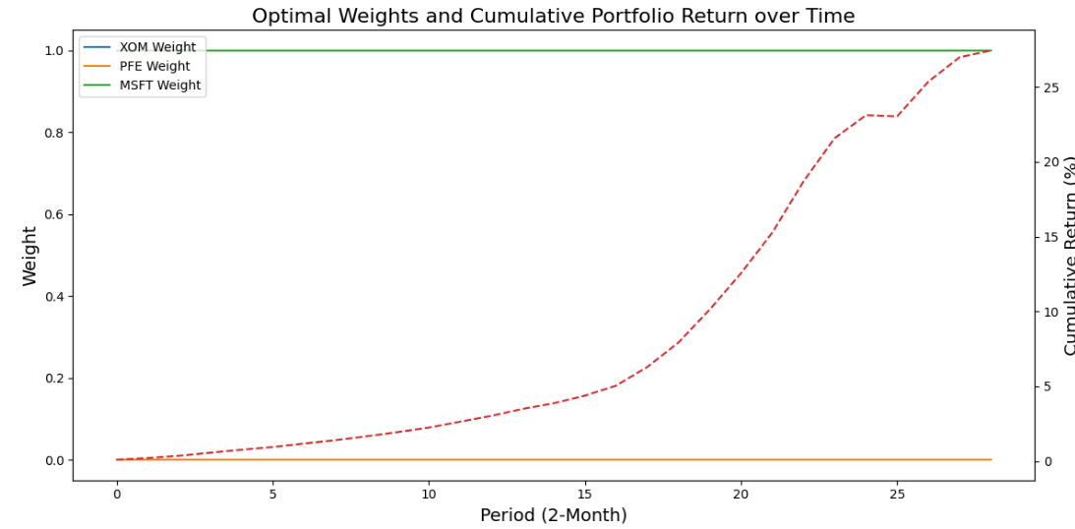
Auto Regressive Integrated Moving Average (ARIMA)
Step 5 : Implementing a dynamic strategical weighting with the predictive equation
IDA Template

Slide 20
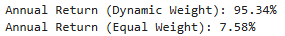
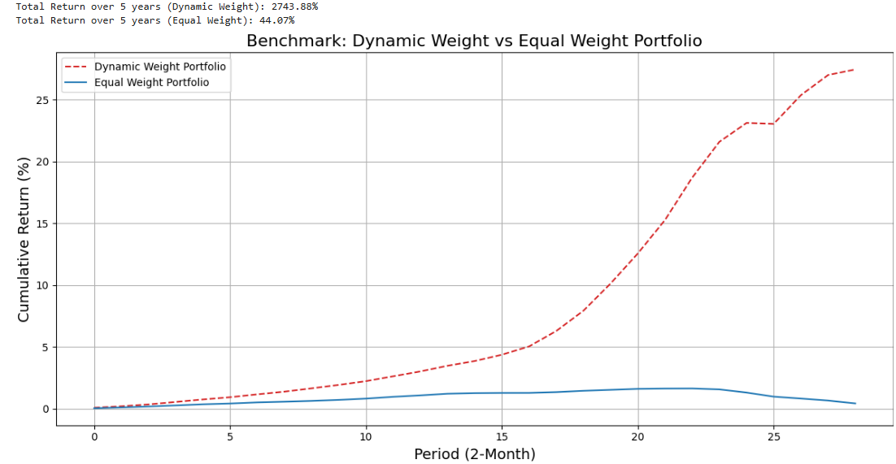
Auto Regressive Integrated Moving Average (ARIMA)
Step 6 : Benchmarking the return from ARIMA model with dynamic-weight strategy and Equal-weight Average Model
Conclusion
The annual return of dynamic-weight strategy with ARIMA predictive equation provide return 12.6 times more than equal-weight average
IDA Template

Slide 21
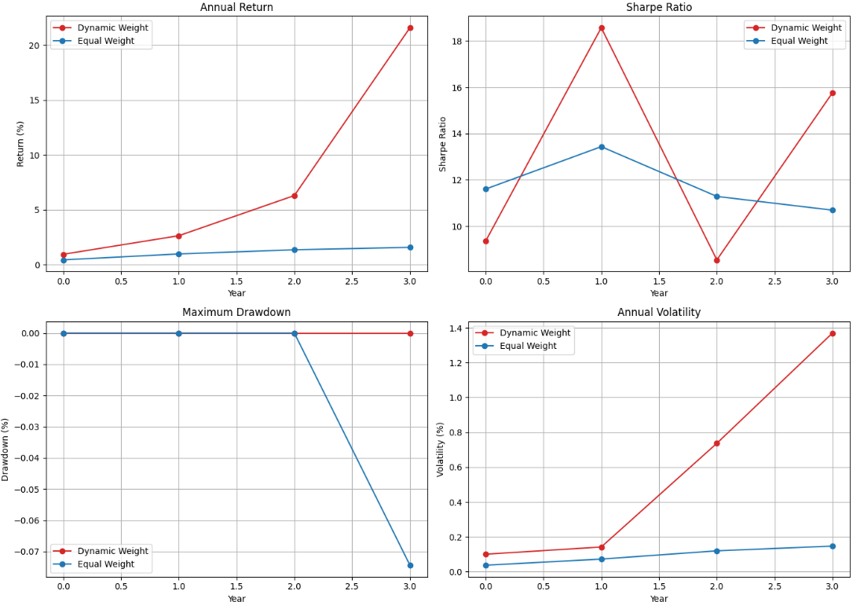
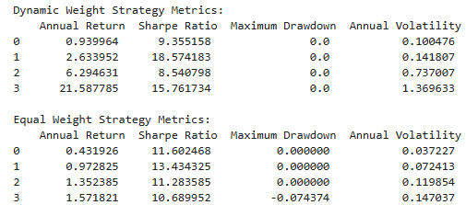
Auto Regressive Integrated Moving Average (ARIMA)
Step 6 : Benchmarking the return from ARIMA model with dynamic-weight strategy and Equal-weight Average Model
Key KPI Measurement:
1.) Annual Return
2.) Annual Sharp Ratio
3.) Max. Drawdown
4.) Annual Volatility
Conclusion
Annual Return: Dynamic strategy is higher
Sharp Ratio: Dynamic strategy is averagely higher
Max. Drawdown: Dynamic strategy is lower
Annual Volatility: Dynamic strategy is higher (From exponential growth)
IDA Template

Slide 22
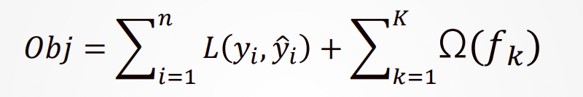
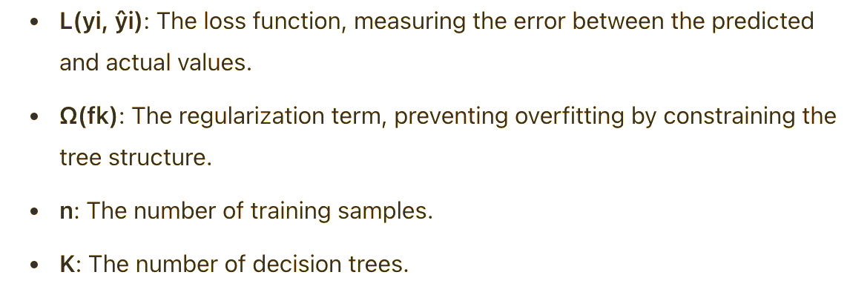
Xtreme Gradient Boosting (XGBooST)
XGBoost (Extreme Gradient Boosting): ► A machine learning model that combines decision trees into an ensemble, optimized using gradient boosting techniques. ► Objective Formula:
IDA Template

Slide 23
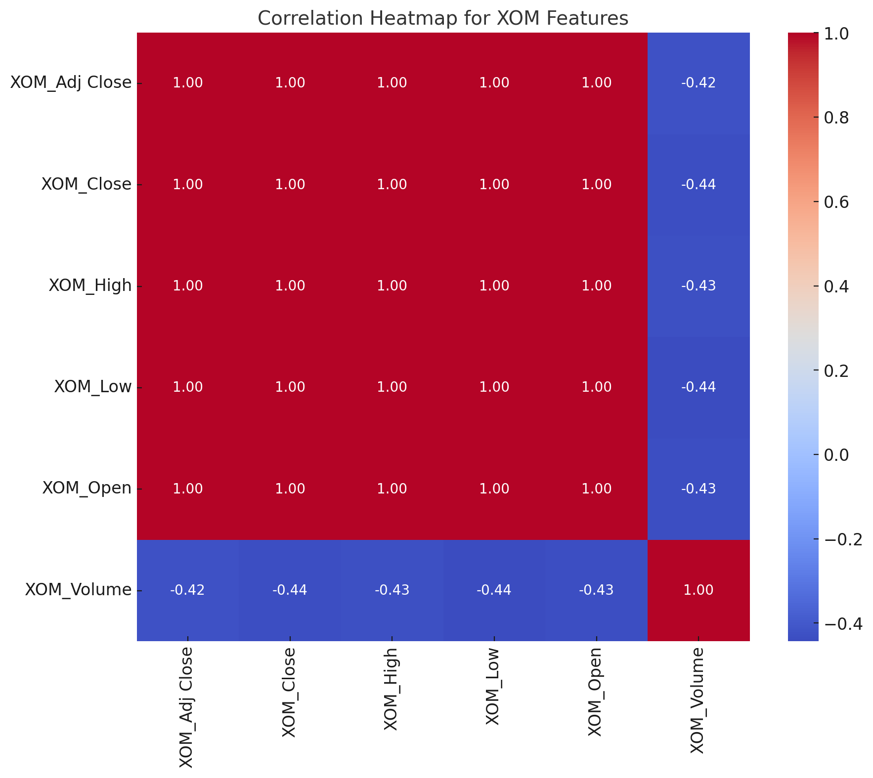
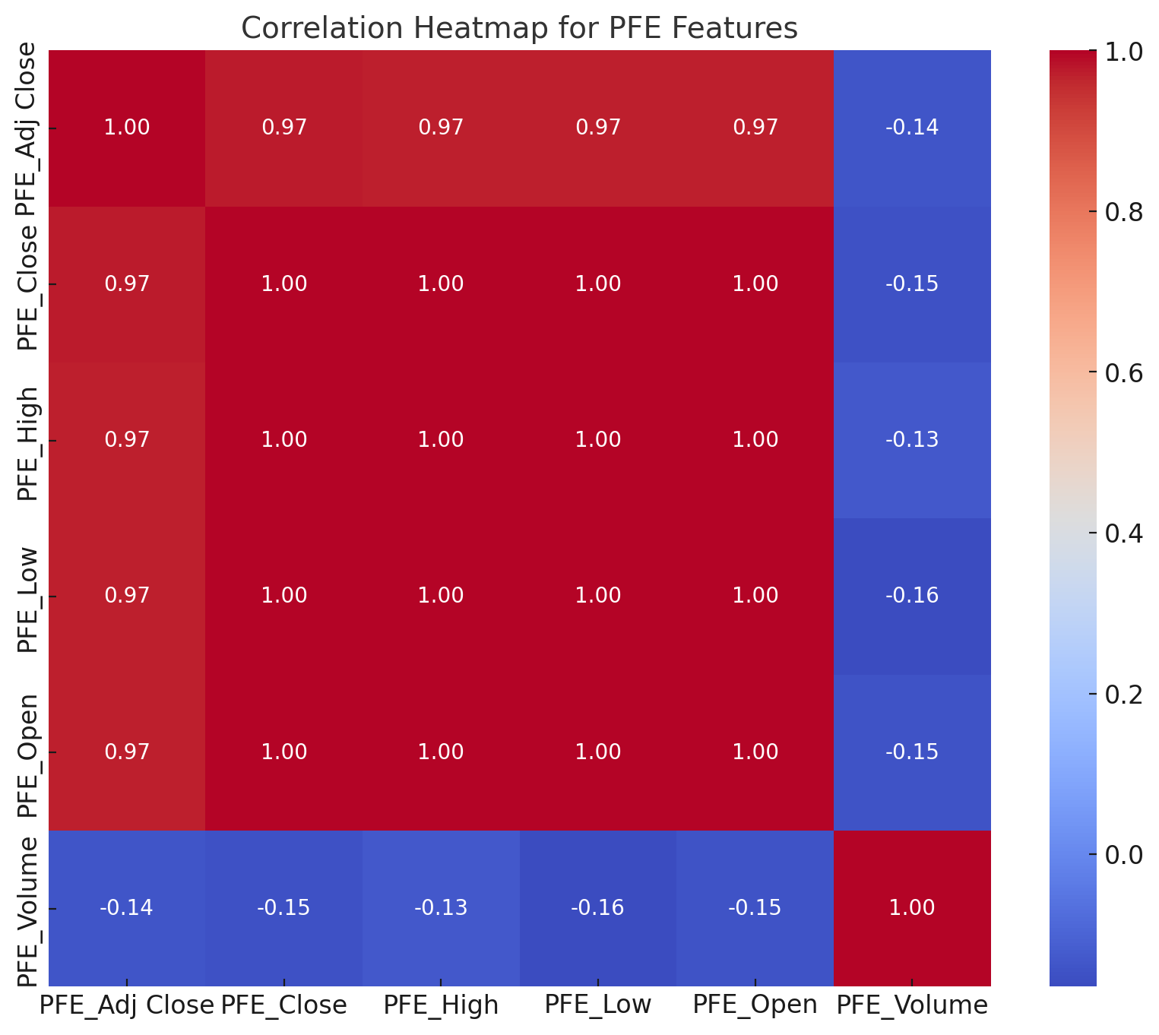
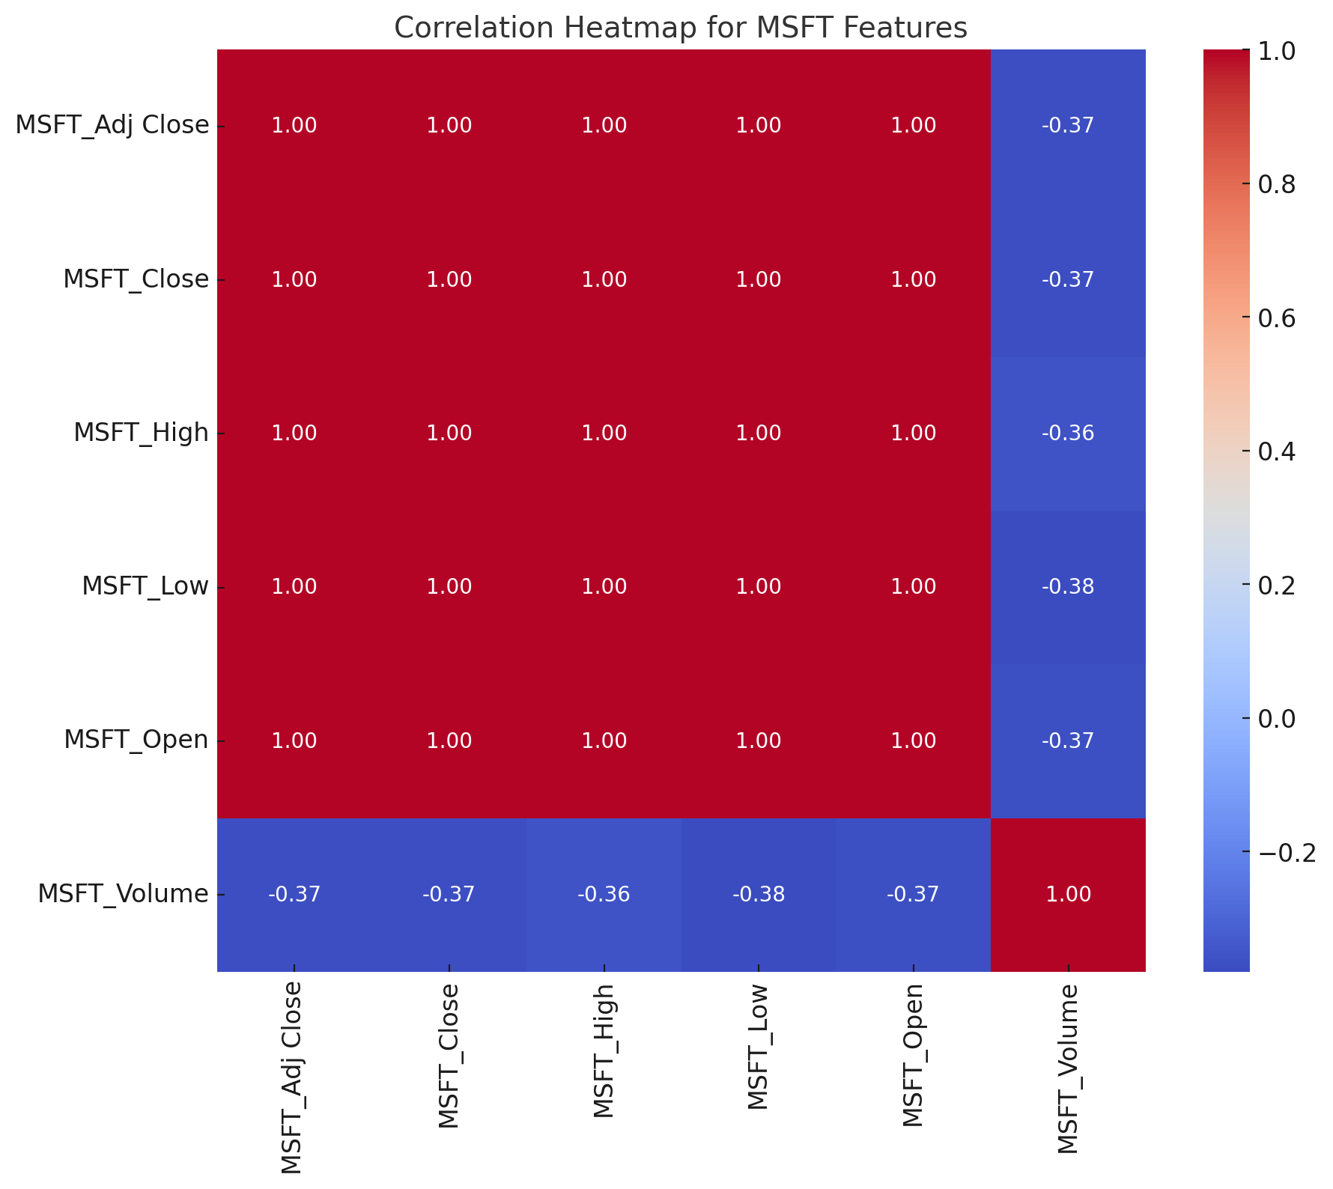
Xtreme Gradient Boosting (XGBooST)
Correlation Heatmap
IDA Template

Slide 24
Xtreme Gradient Boosting (XGBooST)
Step 1 : Feature Engineering-To enhance the model’s learning performance.
Feature | Formula | Explanation
Adj Close | Adj Close=Close × Adjustment Factor | Reflects true returns after dividends/splits.
Close | Last traded price of the day. | Market’s end-of-day valuation
High | Highest traded price of the day. | Maximum market valuation.
Low | Lowest traded price of the day. | Minimum market valuation.
Open | First traded price of the day. | Reflects initial market sentiment.
Volume | Total shares traded during the day. | Indicates market activity and liquidity.
IDA Template

Slide 25
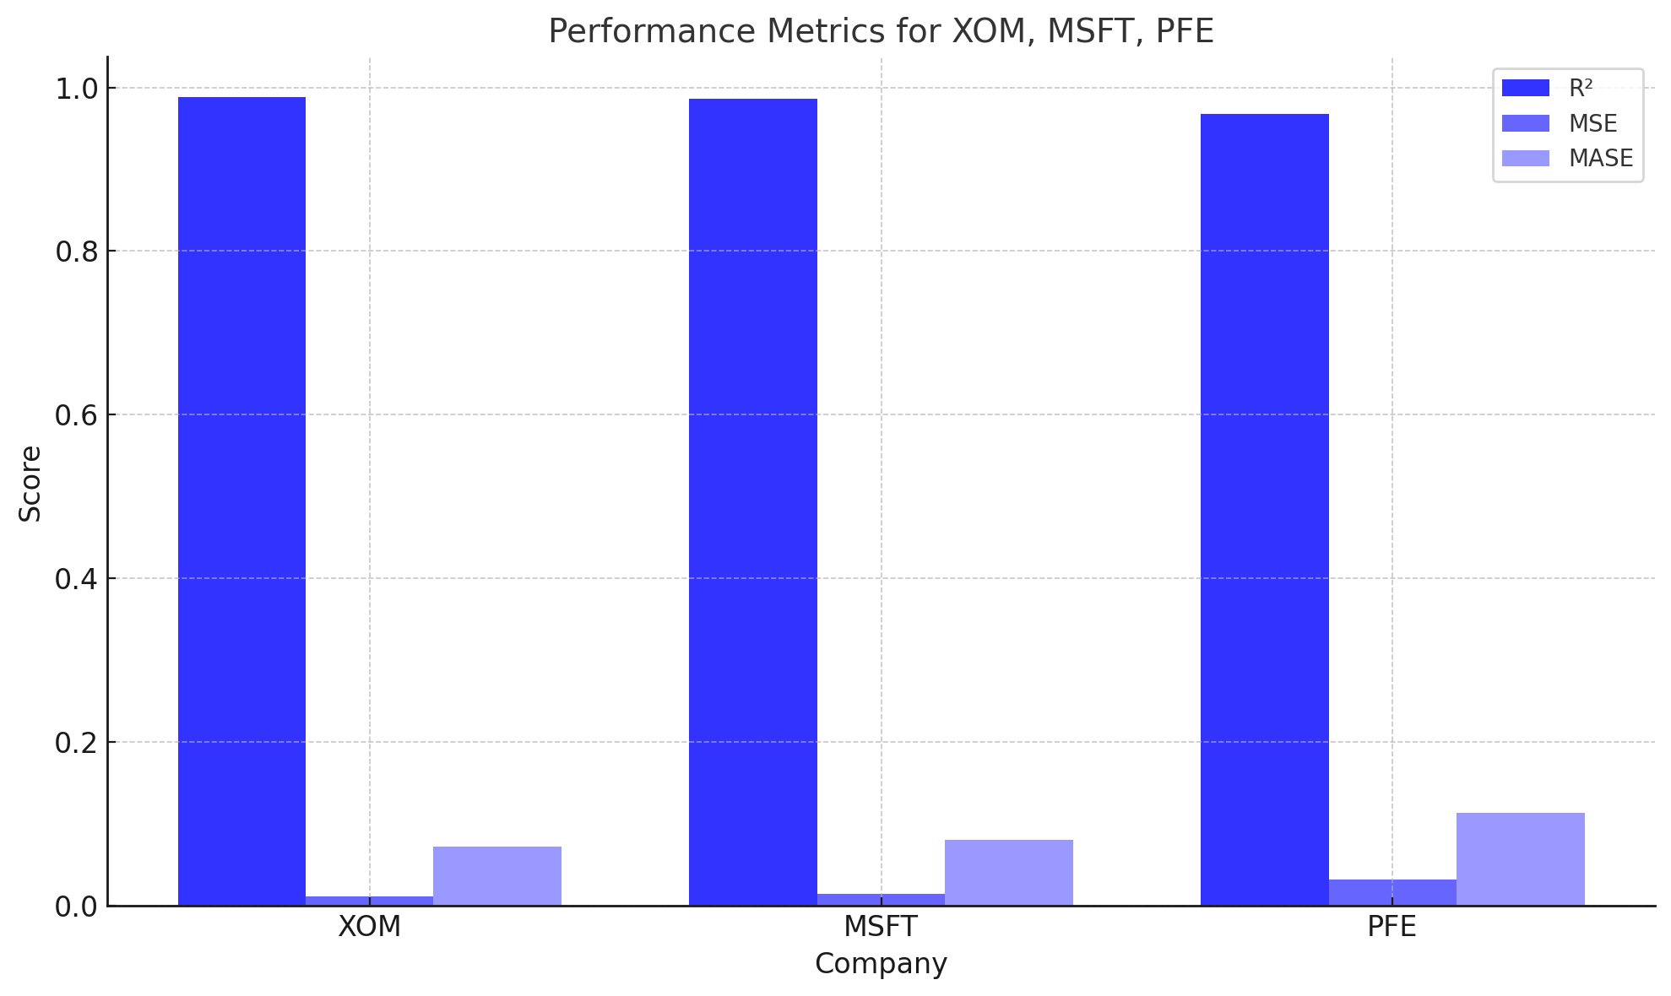
Xtreme Gradient Boosting (XGBooST)
Step 2 : Training and testing data for 70/30
Model Performance on Testing Dataset
Feature | R2 | MSE | MASE
XOM | 0.9886 | 0.0115 | 0.0726
MSFT | 0.9860 | 0.0142 | 0.0805
PFE | 0.9677 | 0.0323 | 0.1138
Overall Conclusion：
The model performs best for XOM, followed by MSFT, while predictions for PFE are less accurate and may require further optimization
IDA Template

Slide 26
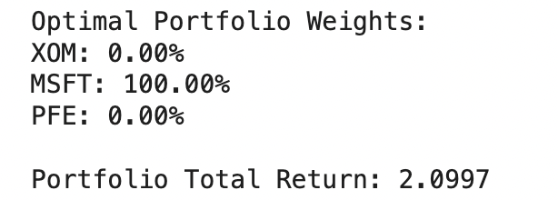
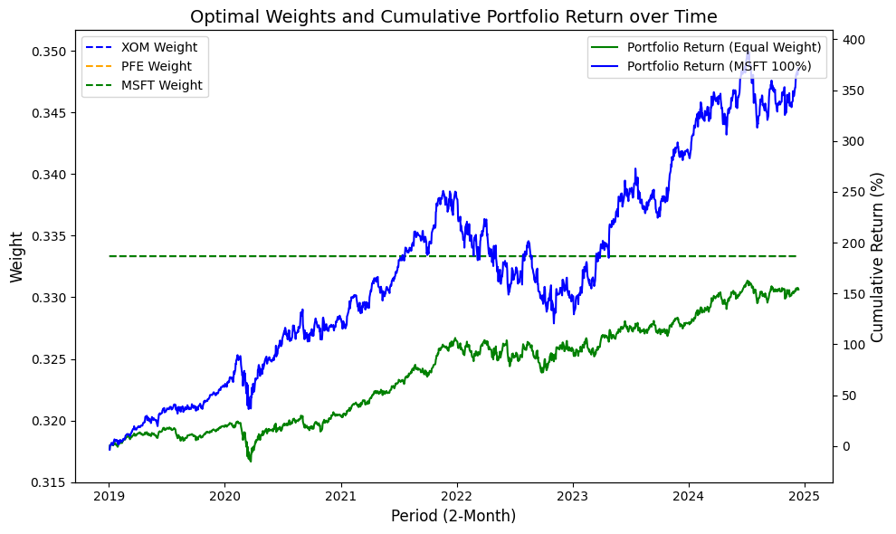
Xtreme Gradient Boosting (XGBooST)
Step 3:
Portfolio Optimization
Calculate portfolio Sharpe Ratio based on test set returns.
Optimize weight allocation, balancing returns and risks.
Conclusion:
The optimal allocation indicates a 100% investment in MSFT. yielding a 5-year cumulative return of 2.0997%.
This highlights MSFT's strong performance but emphasizes the need for diversification to mitigate potential risks.
IDA Template

Slide 27
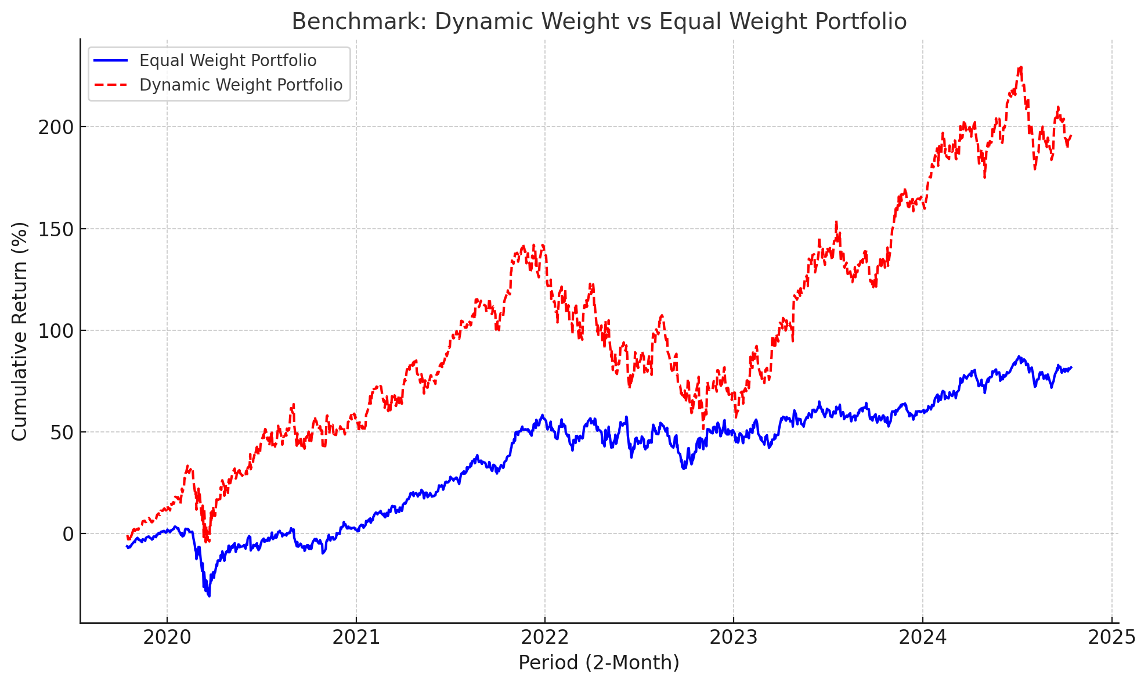
Xtreme Gradient Boosting (XGBooST)
Step 4:
Benchmarking the return from XGBooST model with dynamic-weight strategy and Equal-weight Average Model
Conclusion
The annual return of dynamic-weight strategy with XGBoost predictive equation provide return 1.91 times more than equal-weight average
IDA Template

Slide 28
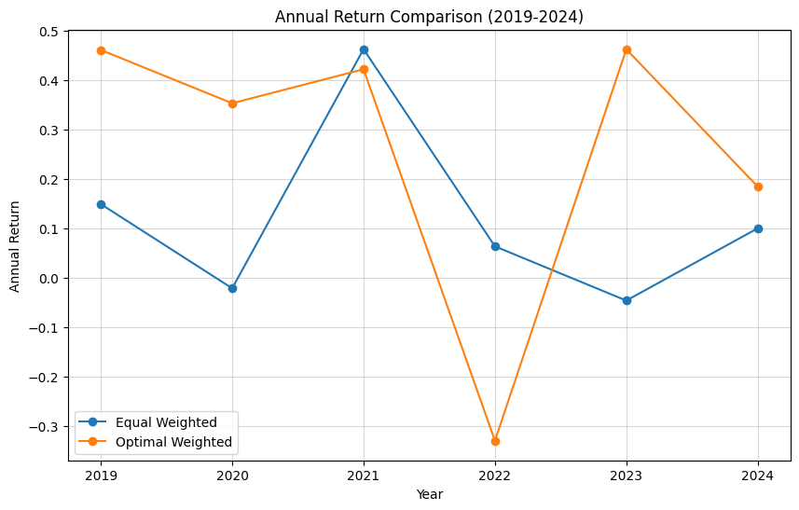
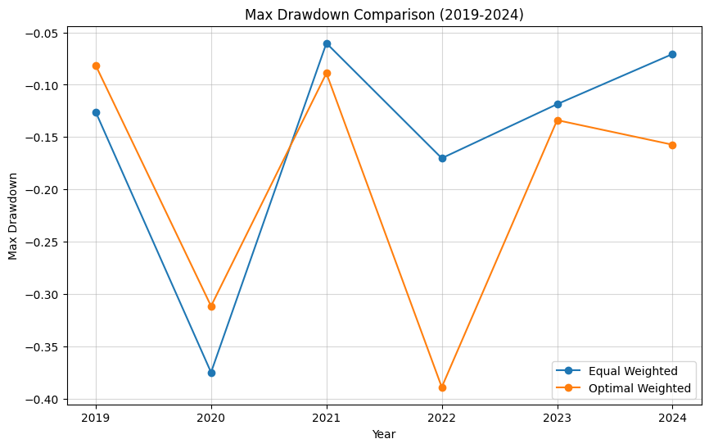
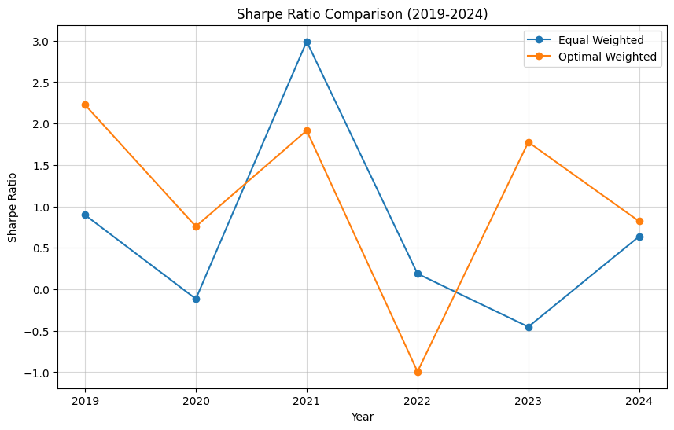
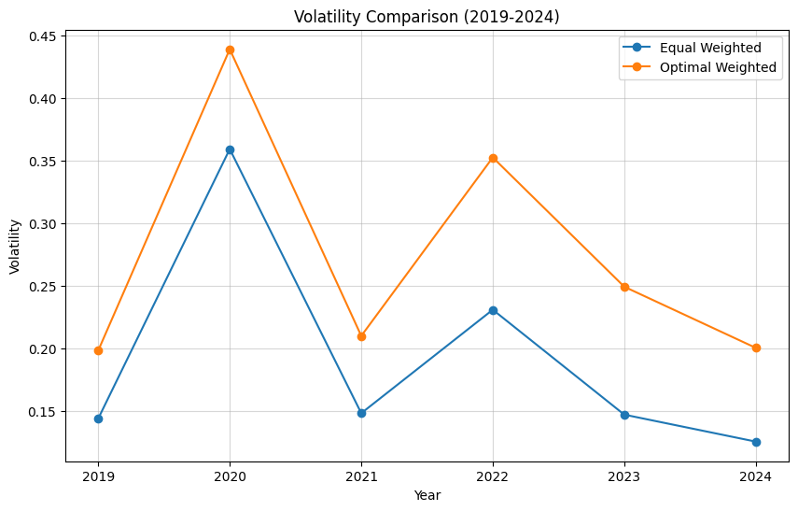
Xtreme Gradient Boosting (XGBooST)
Step 5:
Benchmarking the return from XGBooST model with dynamic-weight strategy and Equal-weight Average Model
Key KPI Measurement:
1.) Annual Return
2.) Annual Sharp Ratio
3.) Max. Drawdown
4.) Annual Volatility
Conclusion:
Annual Return: The optimal weighted strategy generally outperforms the equal weighted strategy, especially in 2021 and 2023.
Max Drawdown: The equal weighted strategy has smaller drawdowns, while the optimal strategy is more volatile.
Sharpe Ratio: The optimal strategy shows better risk-adjusted returns in 2021 and 2022.
Volatility: The optimal strategy has higher volatility, indicating more risk
IDA Template

Slide 29
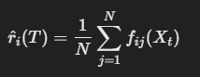


Random Forrest
Objective Eq.:
Predictive Eq.:
IDA Template

Slide 30

Random Forrest
Step 1 : Calculate return from the stocks every 2 months
Step 2 : Identifying Features and Target Variable for the Random Forest Model
IDA Template

Slide 31






Random Forrest
Step 3 : Run Random Forrest model to find the predictive equation and test the model by using K-Fold Cross Validation approach
IDA Template

Slide 32




Random Forrest
Step 4 : Combine predictive equation of returns from XOM, PFE, and MSFT
IDA Template

Slide 33


Random Forrest
Step 5 : Implementing a dynamic strategical weighting with the predictive equation
IDA Template

Slide 34


Random Forrest
Step 6 :
IDA Template

Slide 35




Random Forrest
Step 6 : Benchmarking the return from RF model with dynamic-weight strategy and Equal-weight Average Model
Key KPI Measurement:
1.) Annual Return
2.) Annual Sharp Ratio
3.) Max. Drawdown
4.) Annual Volatility
Conclusion
- Annual Return: Dynamic strategy outperforms equal weighting.
- Sharpe Ratio: Dynamic strategy is generally better.
- Maximum Drawdown: Dynamic strategy has smaller losses.
- Annual Volatility: Dynamic strategy shows higher risk.
IDA Template

Slide 36
Conclusion of Comparison
Model | Avg. Annual Returns (%) | Avg. Annual Sharp Ratio | Max. Draw Down (%) | Avg. Annual Volatility (%)
ARIMA | 21.58 | 15.76 | -0.10 | 58.25
XGBOOST | 26.36 | 0.87 | -37.56 | 30.29
Random Forrest | 13.30 | 8.23 | -0.12 | 17.00
IDA Template

